Slide 1
Time series data analysis with R and EViews

Slide 2
Teaching Objective
Can use R and EViews to
1. test Heteroskedasticity and the Efficient Markets Hypothesis
2. build ARCH model in Stock Returns
3. do Panel Data Analysis

Slide 3
R

Slide 4
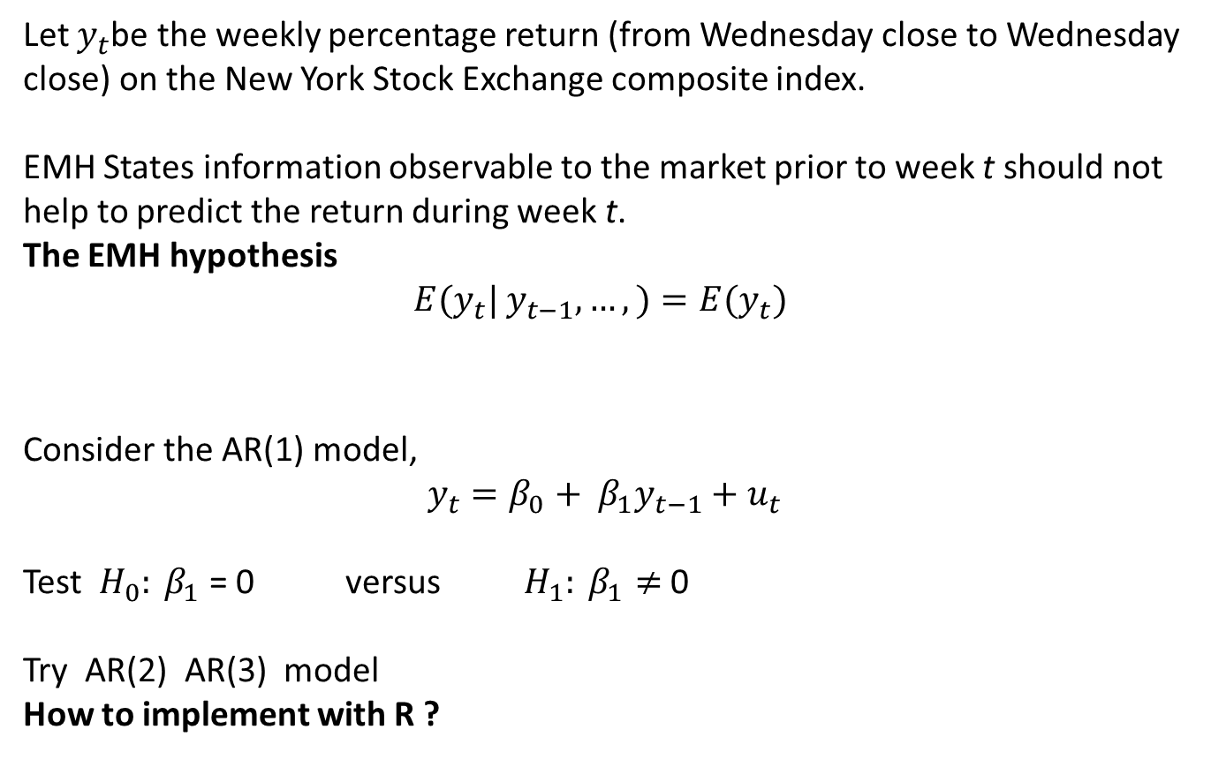
1. Efficient markets hypothesis(EMH)
Let $y_{t}$be the weekly percentage return (from Wednesday close to Wednesday close) on the New York Stock Exchange composite index.
EMH States information observable to the market prior to week t should not help to predict the return during week t.
The EMH hypothesis
$E(y_{t}|$ $y_{t−1},…,)=E(y_{t})$
Consider the AR(1) model,
$$y_{t}=β_{0}+ β_{1}y_{t−1}+u_{t}$$
Test $H_{0}: β_{1}$ = 0 versus $H_{1}: β_{1}≠$0
Try AR(2) AR(3) model
How to implement with R ?
Efficient markets hypothesis
1
Notes:
Install packages: tseries, dynlm, urca, lmtest

Slide 5
1. Efficient markets hypothesis
# Install and load packages (R>=3.4.2)
# foreign: Reading and writing data stored by some versions of 'Epi Info', 'Minitab', 'S', 'SAS', 'SPSS', 'Stata', 'Systat', 'Weka', and for reading and writing some 'dBase' files. read.dta()
# dynlm: Dynamic linear models and time series regression.
# stargazer: Well-Formatted Regression and Summary Statistics Tables
install.packages( “foreign”)
install.packages(“dynlm”)
install.packages(“stargazer”)
library(foreign);
library(dynlm);
library(stargazer)
# Loading data
# foreign(read.dta) : Reads a file in Stata version 5–12 binary format into a data frame.
nyse <- read.dta("http://fmwww.bc.edu/ec-p/data/wooldridge/nyse.dta")
Efficient markets hypothesis
1
Notes:
Install packages: tseries, dynlm, urca, lmtest

Slide 6
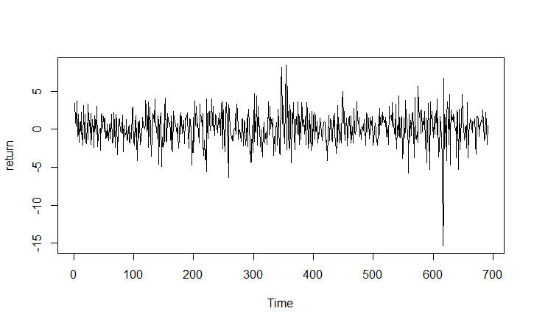
1. Efficient markets hypothesis
# Define time series (numbered 1,...,n)
tsdata <- ts(nyse)
head(tsdata)
ts.plot(tsdata[,'return’])
# Linear regression of models with 1 lag: AR(1)
reg1 <- dynlm(return ~ L(return), data = tsdata)
reg2 <- dynlm(return ~ L(return) + L(return,2), data = tsdata)
reg3 <- dynlm(return ~ L(return) + L(return, 2) + L(return, 3), data = tsdata)
# Try ?? Dynlm
Efficient markets hypothesis
1
Notes:
Install packages: tseries, dynlm, urca, lmtest

Slide 7
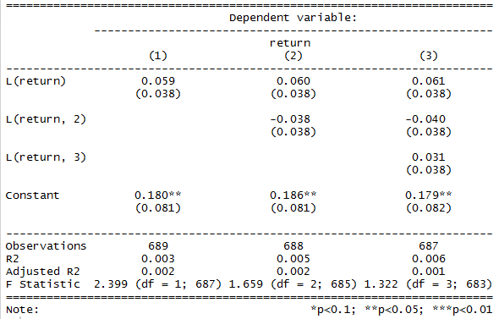
1. Efficient markets hypothesis
# Pretty regression table
stargazer(reg1, reg2, reg3, type="text", keep.stat = c("n","rsq","adj.rsq","f"))
Conclusion: It is not strong enough to warrant rejection of the efficient markets hypothesis.
Efficient markets hypothesis
2
Notes:
Install packages: tseries, dynlm, urca, lmtest

Slide 8

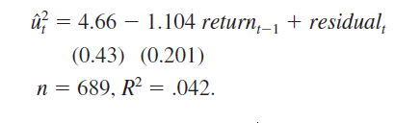
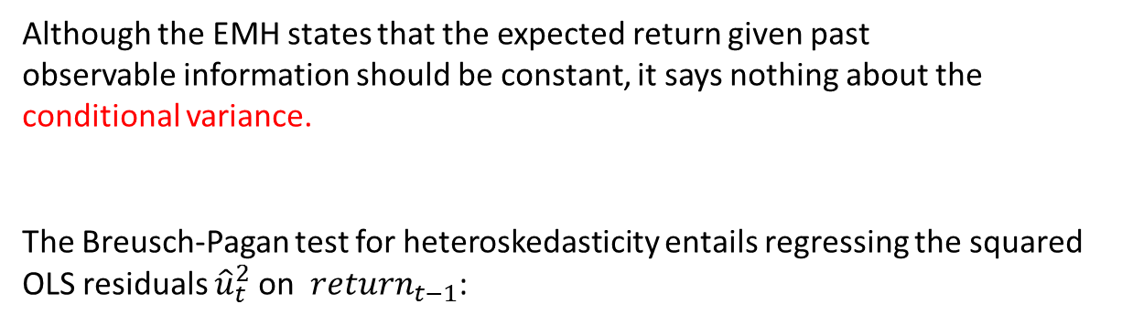
2. Heteroskedasticity and the efficient markets hypothesis
Although the EMH states that the expected return given past
observable information should be constant, it says nothing about the conditional variance.
The Breusch-Pagan test for heteroskedasticity entails regressing the squared OLS residuals ${\hat{u}}_{t}^{2}$on ${return}_{t−1}$:
How to implement with R ?
Heteroskedasticity and the efficient markets hypothesis
3
Notes:
Install packages: tseries, dynlm, urca, lmtest

Slide 9
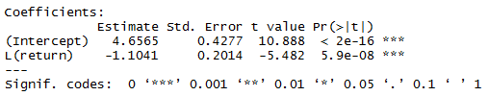
2. Heteroskedasticity and the efficient markets hypothesis
# Breusch-Pagan test for heteroskedasticity
resid.sq <- residuals(reg1)^2
summary( dynlm(resid.sq ~ L(return), data = tsdata) )
Conclusion:
The volatility in stock returns is lower when the previous return was high, and vice versa.
The expected value of stock returns does not depend on past returns,
but the variance of returns does.
3
Heteroskedasticity and the efficient markets hypothesis
Notes:
Install packages: tseries, dynlm, urca, lmtest

Slide 10

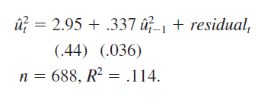
3. ARCH in stock returns
We can model heteroskedasticity in weekly stock returns by autoregressive conditional heteroskedasticity(ARCH)model
ARCH in stock returns
4
Notes:
Install packages: tseries, dynlm, urca, lmtest

Slide 11
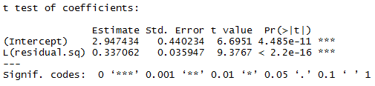
3. ARCH in stock returns
# Linear regression of model:
reg <- dynlm(return ~ L(return), data = tsdata)
# squared residual
residual.sq <- resid(reg)^2
# Model for squared residual:
ARCHreg <- dynlm(residual.sq ~ L(residual.sq))
install.packages("lmtest") ; library(lmtest) # Testing Linear Regression Models
coeftest(ARCHreg)
ARCH in stock returns
4
Notes:
Install packages: tseries, dynlm, urca, lmtest

Slide 12

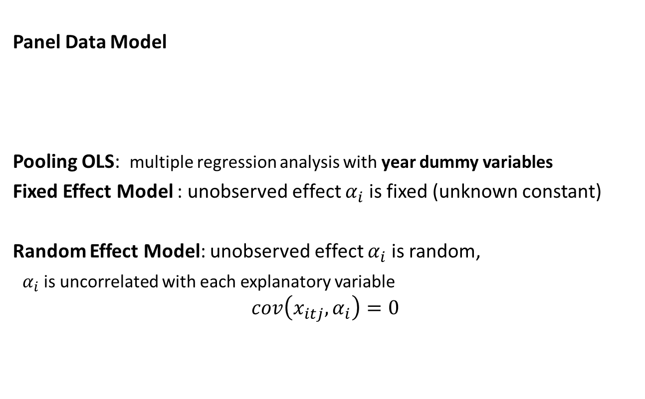
4. A wage equation using panel data
Panel Data Model
Pooling OLS: multiple regression analysis with year dummy variables
Fixed Effect Model : unobserved effect $α_{i}$ is fixed (unknown constant)
Random Effect Model: unobserved effect $α_{i}$ is random,
$α_{i}$ is uncorrelated with each explanatory variable
$$cov\left(x_{itj},α_{i}\right)=0$$
A wage equation using panel data
5
Notes:
Install packages: tseries, dynlm, urca, lmtest

Slide 13
4. A wage equation using panel data
R Package Formula
Title: Extended Model Formulas
Description Infrastructure for extended formulas with multiple parts on the right-hand side and/or multiple responses on the left-hand side
R Package plm
plm: Linear Models for Panel Data
A set of estimators and tests for panel data econometrics.
# install load required packages
install.packages("Formula");
install.packages("plm");
library(foreign); library(Formula); library(plm); library(stargazer)
A wage equation using panel data
5
Notes:
Install packages: tseries, dynlm, urca, lmtest

Slide 14
Example 14.4: A wage equation using panel data
# Read Data into R
wagepan <- read.dta("http://fmwww.bc.edu/ec-p/data/wooldridge/wagepan.dta")
# Generate pdata.frame:
wagepan.p <- pdata.frame(wagepan, index=c("nr","year"))
pdim(wagepan.p)
> Balanced Panel: n = 545, T = 8, N = 4360
# Check variation of variables within individuals
pvar(wagepan.p)
> no time variation: nr black hisp educ
> no individual variation: year d81 d82 d83 d84 d85 d86 d87
Pooled OLS
educ + black + hisp + exper + exper^2 + married + union + year
Random Effects
educ + black + hisp + exper + exper^2 + married + union + year
Fixed Effects
exper^2 + married + union + year
A wage equation using panel data
5
Notes:
Install packages: tseries, dynlm, urca, lmtest

Slide 15
4. A wage equation using panel data
# Estimate different models, year as dummy variable in the models
wagepan.p$yr <- factor(wagepan.p$year)
reg.ols <- plm(lwage ~ educ + black + hisp + exper + I(exper^2) + married + union + yr,
data = wagepan.p, model = "pooling")
reg.re <- plm(lwage ~ educ + black + hisp + exper + I(exper^2) + married + union + yr,
data = wagepan.p, model = "random")
reg.fe <- plm(lwage ~ I(exper^2) + married + union + yr,
data = wagepan.p, model = "within")
# Table of selected results (not reporting year dummies)
stargazer(reg.ols, reg.re, reg.fe, type = "text",
column.labels = c("OLS","RE","FE"), keep.stat = c("n","rsq"),
keep = c("ed","bl","hi","exp","mar","un"))
A wage equation using panel data
6
Notes:
Install packages: tseries, dynlm, urca, lmtest

Slide 16
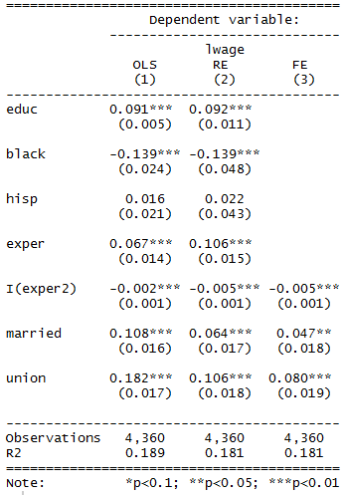
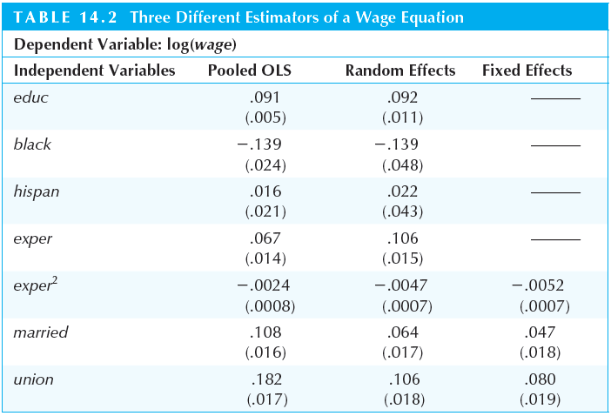
4: A wage equation using panel data
A wage equation using panel data
7
Notes:
Install packages: tseries, dynlm, urca, lmtest

Slide 17
Eviews

Slide 18
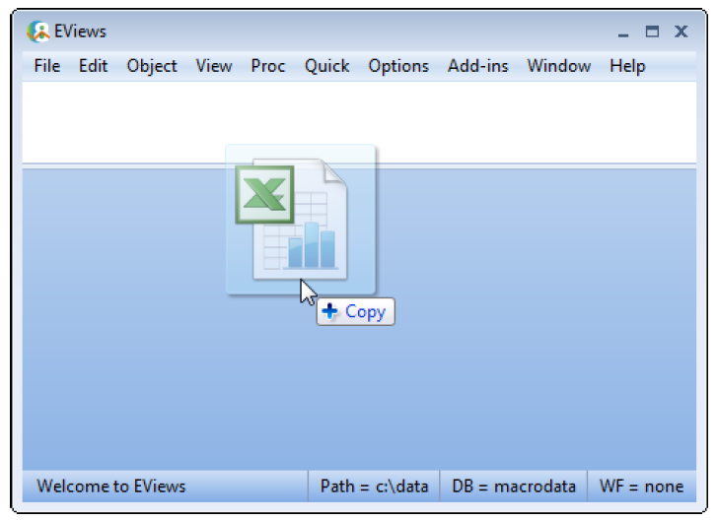
Example 11.4: testing Efficient Markets Hypothesis
Step1: Import Data
Drag-and-drop the file nyse.xlsx into background area of the main EViews window
testing Efficient Markets Hypothesis
1

Slide 19
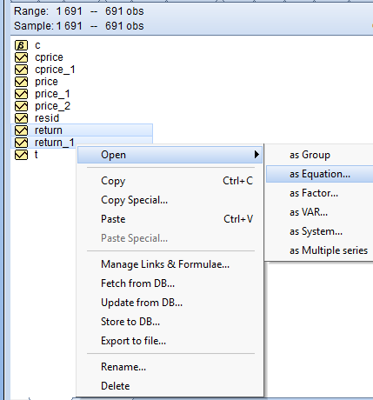
1. Testing Efficient Markets Hypothesis
Step1: Perform linear regression of return on return_1
First, highlight return in the workfile window by single clicking on the entry. Next, CTRL-click return_1, right click and select Open/as Equation… .
testing Efficient Markets Hypothesis
2

Slide 20
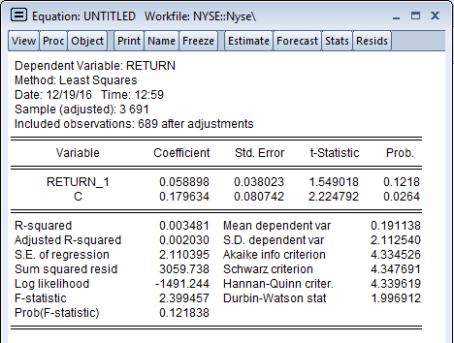
EViews: Equation output
testing Efficient Markets Hypothesis
3

Slide 21
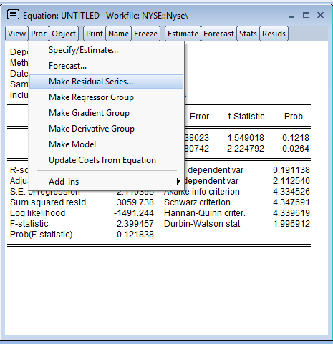
Save residuals for BP test and ARCH test
Step 2.1: Save residuals as object
In the equation output window, click “Proc” and select Make Residual Series.
Save residuals for BP test and ARCH test
4

Slide 22
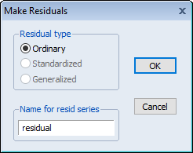
EViews: Save residuals for BP test and ARCH test
Step 2.2: Save residuals as object
In the Make Residuals window, enter the series name as residual.
Save residuals for BP test and ARCH test
5

Slide 23
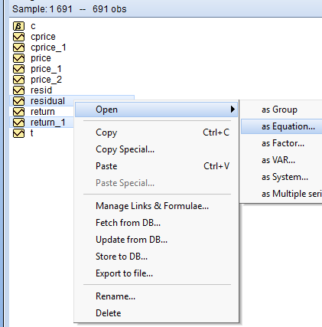
2. BP test for heteroskedasticity: regressing squared residuals on lagged return
Step3: Regress squared residuals on return_1
First, highlight residual in the workfile window by single clicking on the entry. Next, CTRL-click return_1, right click and select Open/as Equation… .
BP test for heteroskedasticity: regressing squared residuals on lagged return
6

Slide 24
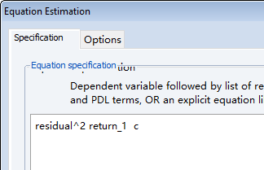
2. Heteroskedasticity and EMH
Specify an equation by formula
In the Equation specification input panel, enter the dependent variable as “residual^2” for squared residuals.
7
Heteroskedasticity and EMH

Slide 25
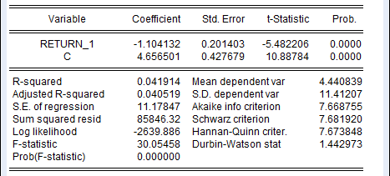
EViews: Equation output
Heteroskedasticity and EMH
8

Slide 26
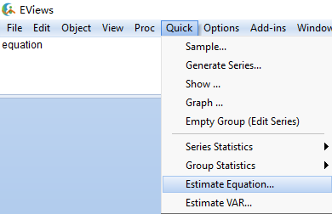
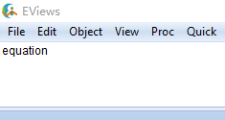
3. ARCH in stock returns
Step4: Regress squared residuals on lagged squared residuals
First, select Quick/Estimate Equation… from the main menu, or simply type the keyword equation in the command window.
ARCH in stock returns
9

Slide 27

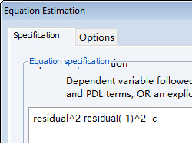
3. ARCH in stock returns
Specify an equation by formula
In the Equation specification input panel, enter “resid_sq^2” for squared residuals and “resid_sq(-1)^2” for lagged squared residuals
ARCH in stock returns
10

Slide 28
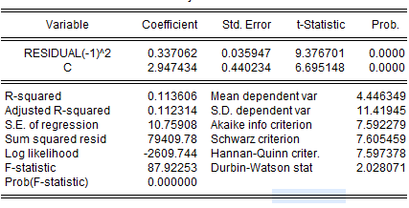
EViews: Equation output
ARCH in stock returns
11

Slide 29
4. A wage equation using panel data
Step1: Import Data
Drag-and-drop the file wagepan.xlsx into background area of the main EViews window
A wage equation using panel data
12

Slide 30
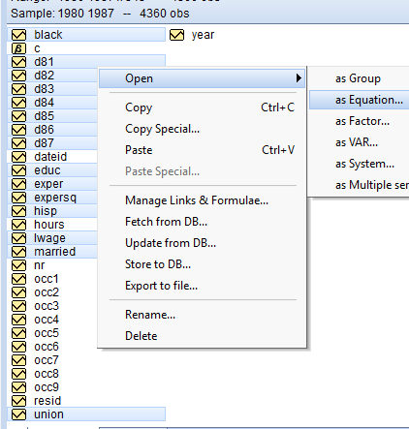
Pooled OLS regression
Step1: pooled OLS of lwage
First, highlight lwage in the workfile window by single clicking on the entry. Next, CTRL-click educ, black, hisp, exper, expersq, married, union, d81, d82, d83, d84, d85, d86, d87, right click and select Open/as Equation… .
pooled OLS regression
13

Slide 31
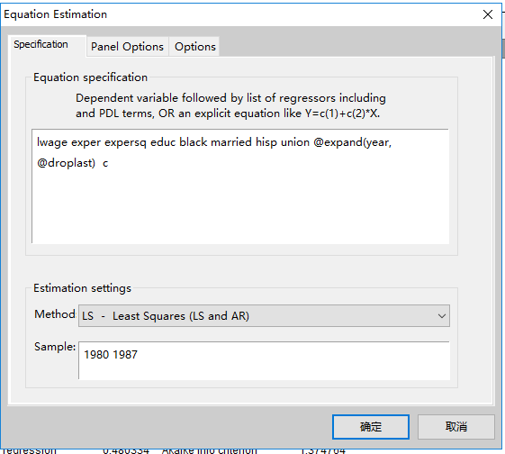
Pooled OLS regression Equivalent Way

Slide 32
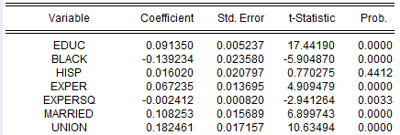
EViews: Equation output
pooled OLS regression
14

Slide 33
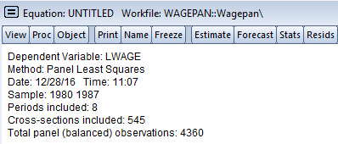
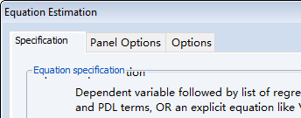
Random effect equation
Step 2.1: Specify as random effects equation
In the equation output window, click “Estimate” to open equation specification window, then select Panel Options.
Random effect equation
15

Slide 34
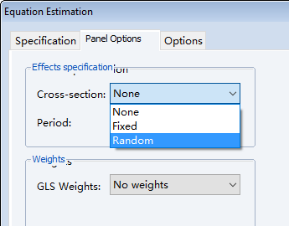
Random effect equation
Step 2.1: Specify as random effects equation
In the equation estimation window, select “Random” to specify the random effect equation.
Random effect equation
16

Slide 35
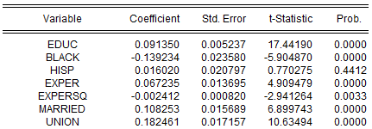
EViews: Equation output
Random effect equation
17

Slide 36
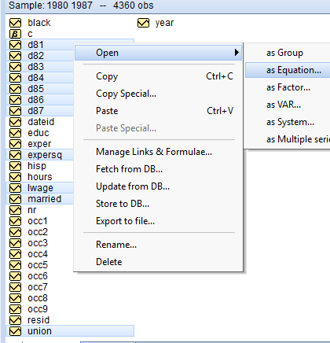
Fixed effect equation
Step3.1: drop the fixed variables and exper
To drop variables, CTRL-click educ, black, hisp, exper, then these variables will be dropped. Right click and select Open/as Equation… .
Fixed effect equation
18

Slide 37
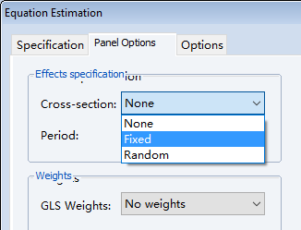
Fixed effect equation
Step 3.2: Specify as fixed effects equation
In the equation estimation window, select “Fixed” to specify the fixed effect equation.
Fixed effect equation
19

Slide 38

EViews: Equation output
Fixed effect equation
20

Slide 39
To learn more about EViews, go to
http://www.eviews.com/Learning/index.html

